Slide 1

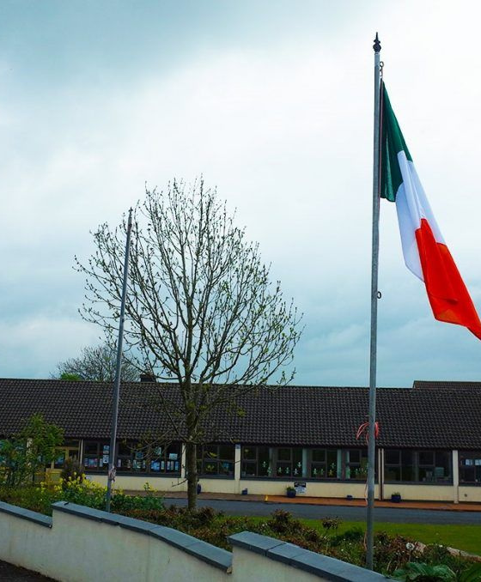
Our School Social Story
2026-2027
Welcome to Crehana N.S.

Slide 2
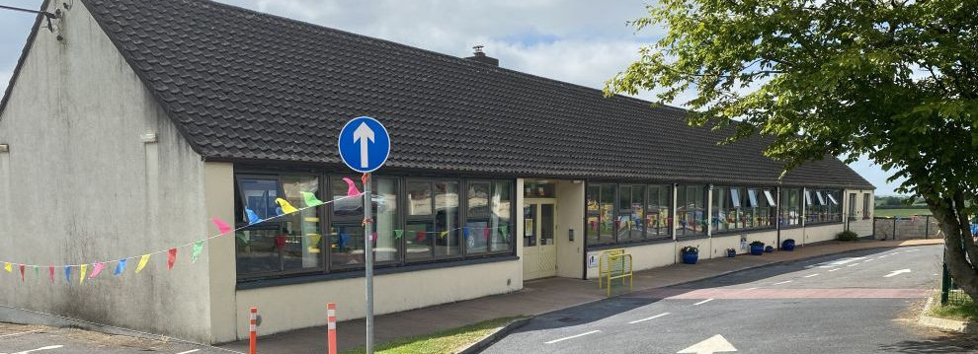
🏫 My School — Crehana N.S.
I am going to school at Crehana N.S.
School is a place to learn, play and spend time with others.
Many adults work here, and each has an important job.

Slide 3
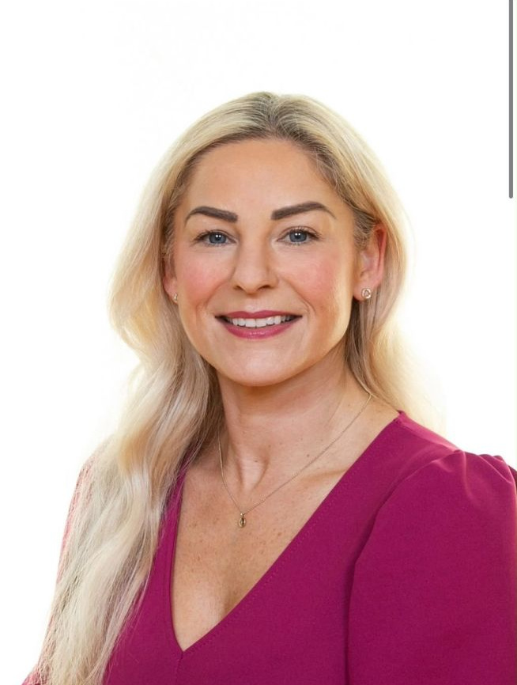
Our Principal
Ms Sinead O'Reilly
Ms Sinead O'Reilly is the day-to-day leader of our school.
She leads teaching and learning and has many other important jobs.
She is also our DLP (Designated Liaison Person for Child Protection).

Slide 4
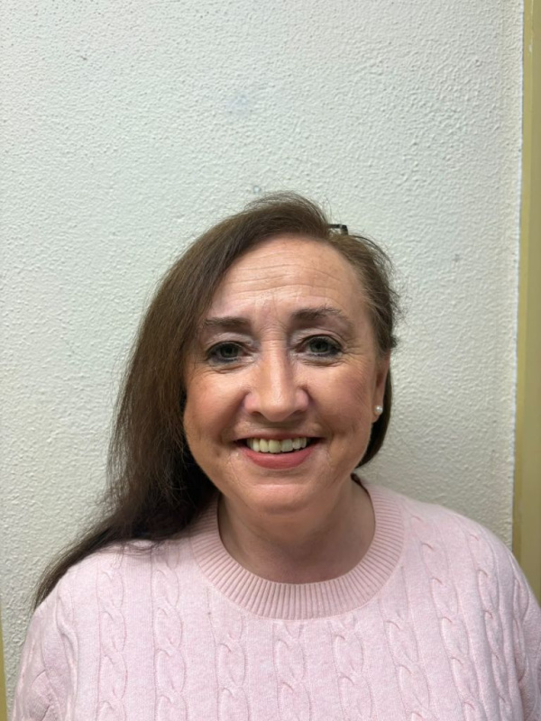
Our School Secretary
This is our school secretary. Her name is Ms. Breda Hanrahan.
Our school secretary works in the school office.
The secretary helps people at school.

Slide 5
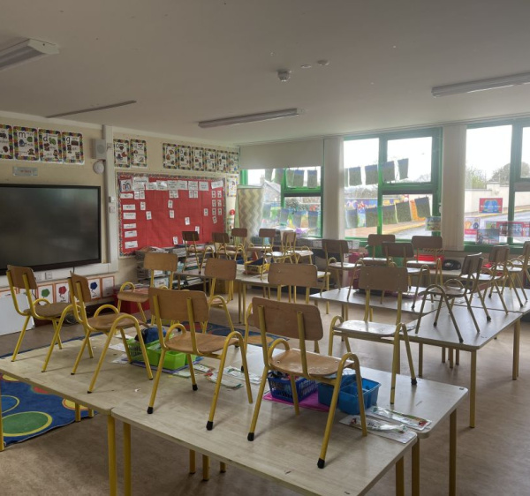
The Classrooms
There are lots of different classrooms in our school. Every classroom is a place for learning, playing and discovering new things.

Slide 6
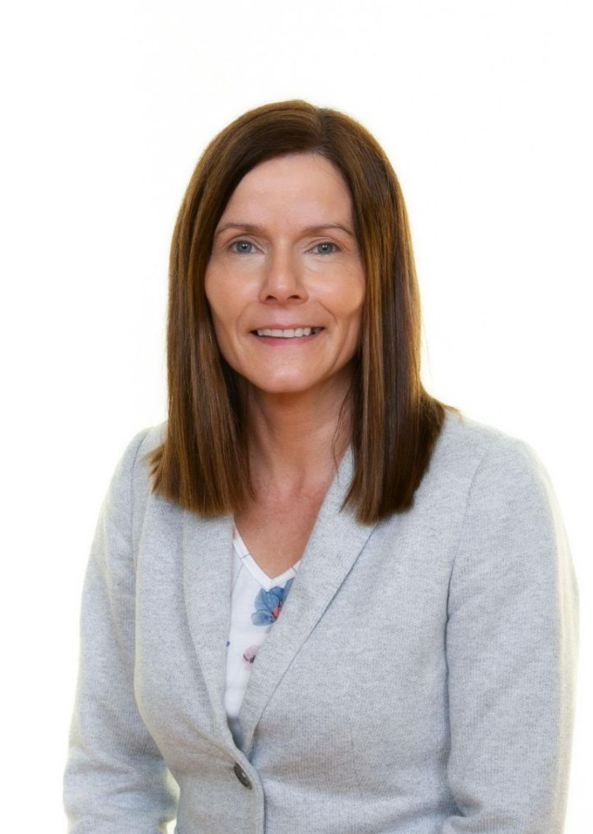
Infants classroom
Mrs Foster teaches Junior and Senior Infants.
This is where the youngest children in our school learn and play.
Mrs. Foster is also our Deputy Principal. She is also our DDLP. (Deputy Designated Liason Person)

Slide 7
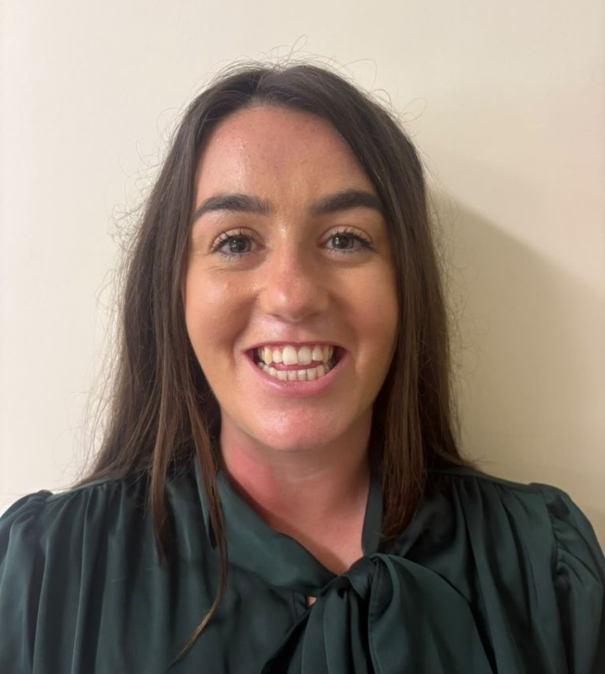
1st and 2nd Class
Ms Shanahan teaches 1st and 2nd Class.
In this classroom, children read bigger books, explore numbers and learn exciting new skills each day.

Slide 8
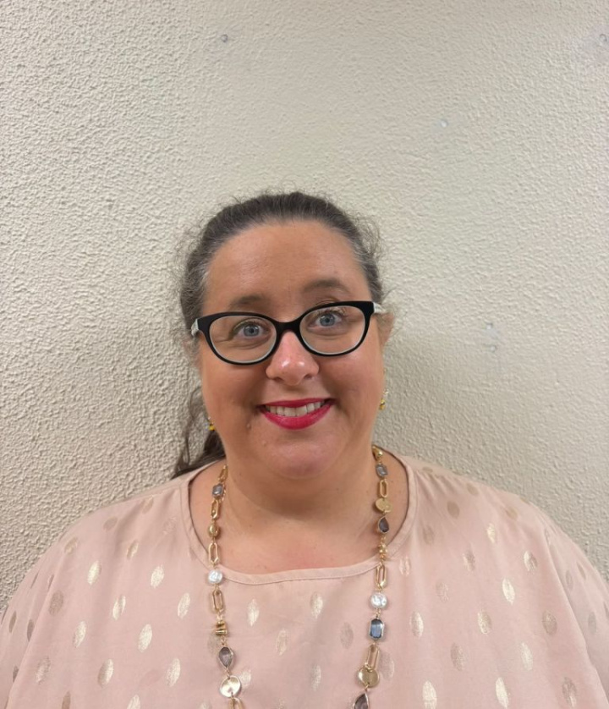
3rd and 4th Class
Mrs. Murphy teaches 3rd and 4th Class.
In this classroom, children take on new projects, read longer stories and learn how to work together as a team.

Slide 9
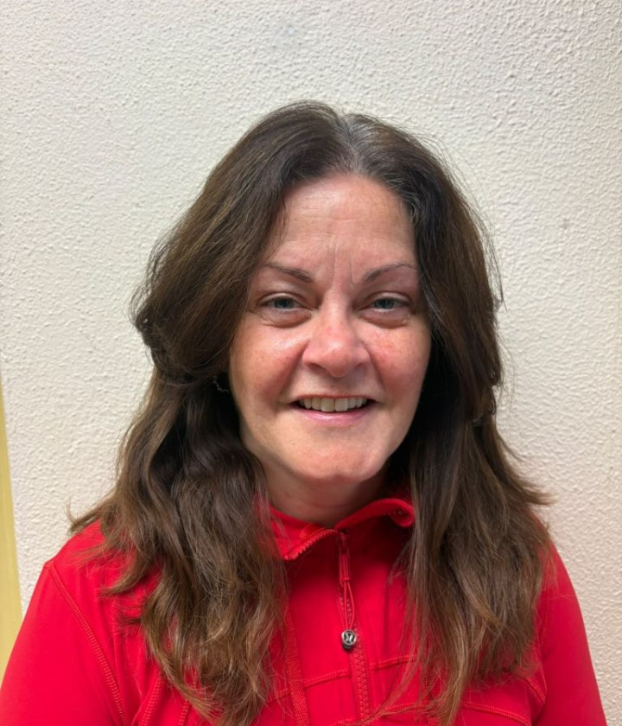
5th Class
Ms. Fahey teaches 5th Class.
Ms. Fahey is also our APII (Assistant Principal II)
In this classroom, children take on greater responsibilities, tackle exciting new subjects and prepare to become the senior leaders of our school.

Slide 10
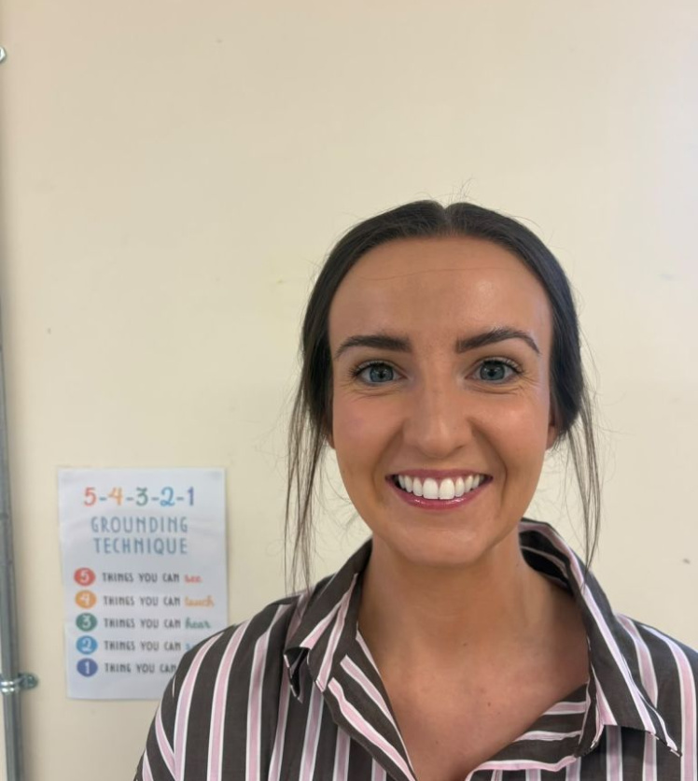
6th Class
Ms. Whyte teaches 6th Class.
6th Class is where the oldest children in our school learn and spend time together, setting a wonderful example for everyone in Crehana N.S.

Slide 11
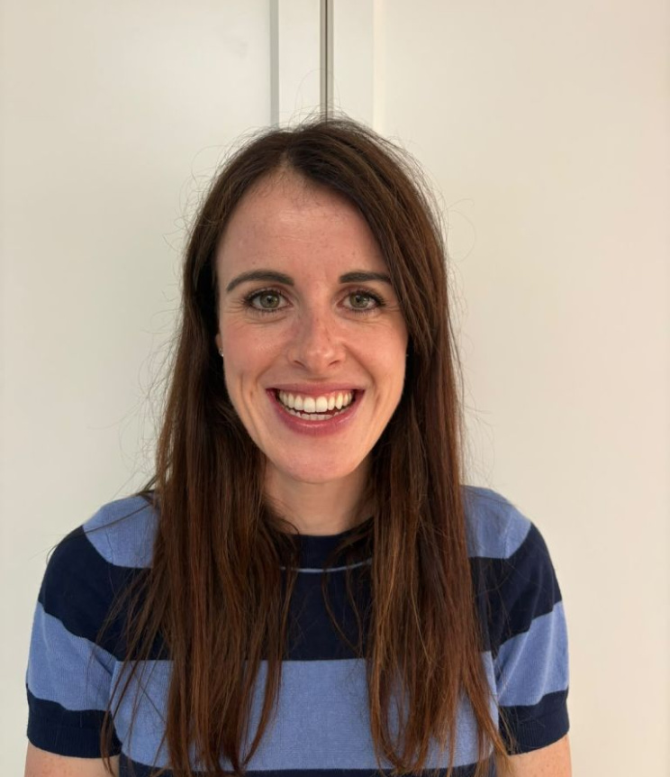
Support classes
Autism Support
Mrs. Fortune teaches here, supporting children in calm, caring ways. In this classroom children can learn and be supported in ways that are right for them.

Slide 12
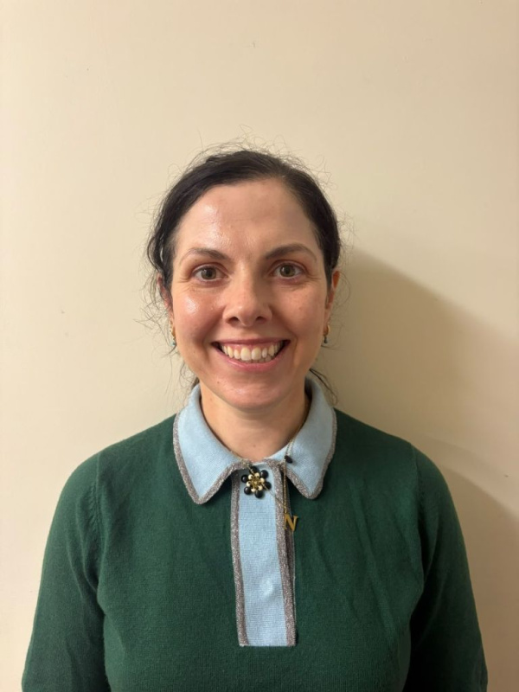
Inclusion Class
Ms. Clifford is the teacher in our Inclusion Class.
The children in this classroom may learn and play in their own classroom and may also take part in activities with other children in the school.

Slide 13
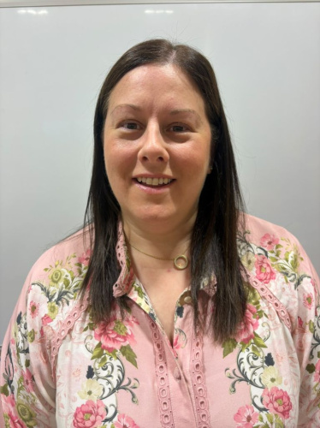
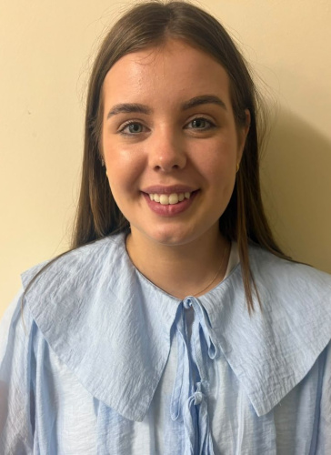
People Who Help With Learning
Some children work with other teachers during the school day. Mrs Bailey and Ms McClean are our Learning Support Teachers. They work with children to support their learning.
Mrs Bailey
Ms McClean

Slide 14
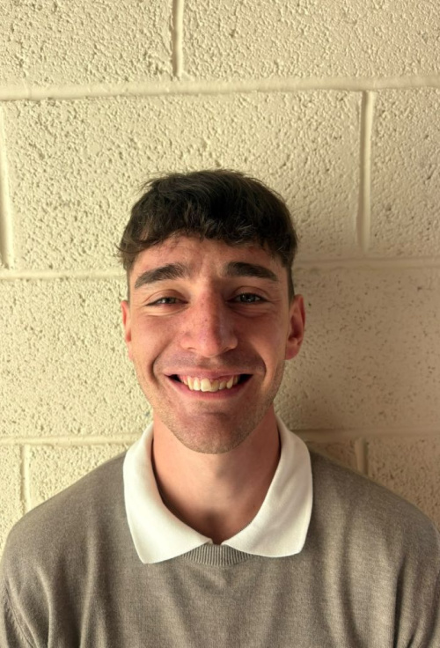
Our EAL Teacher
Mr O'Loughlin is our EAL teacher. He supports children who are learning English as an additional language. Different children may work with different teachers at different times. This is one of the ways children are supported at school.

Slide 15
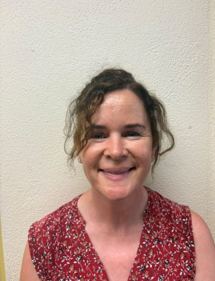
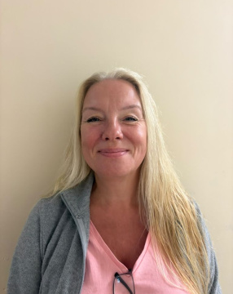
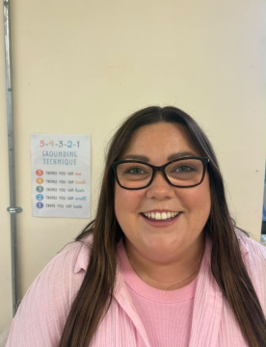
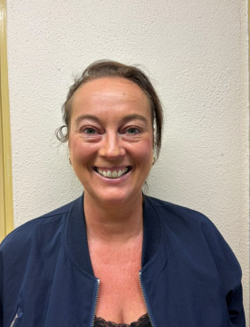
Our Mainstream Class SNAs
There are eight SNAs in Crehana N.S.
SNAs are part of our school team.
They support children in different ways during the school day.
I may see an SNA in my classroom, outside, or in another part of the school.
I can get to know the adults who are part of my school day.
Ursula O’Regan
Audrey Blair
Sinéad O’Regan
Sharon Moore

Slide 16
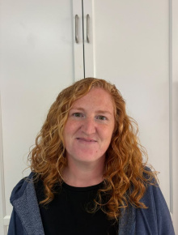
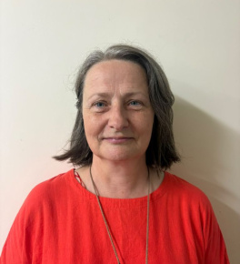
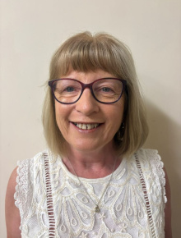
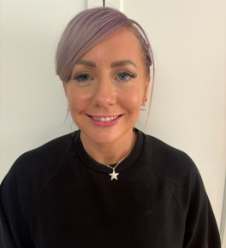
Our Special Class SNAs
Eileen O’Shea
Bridget Ann Whelan
Theresa Kearns
Michelle Phelan

Slide 17
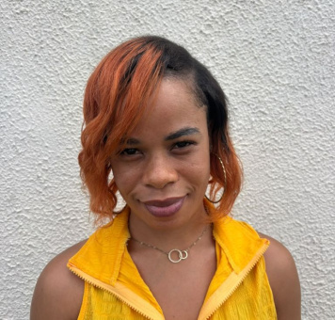
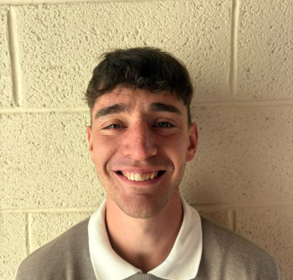
Caring for our school
Catherine
Catherine keeps our school spotless, clean, and tidy every single day.
Mr O'Loughlin
He is also our caretaker! He looks after our building and repairs things.

Slide 18
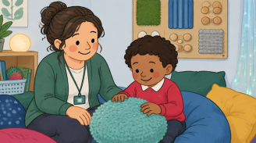
Adults at School Can Help Me
There are many adults at Crehana N.S.
There are adults in school who can help me.
I can talk to my teacher or another trusted adult if I have a question, need help or feel unsure about something.
It is okay to ask for help.

Slide 19
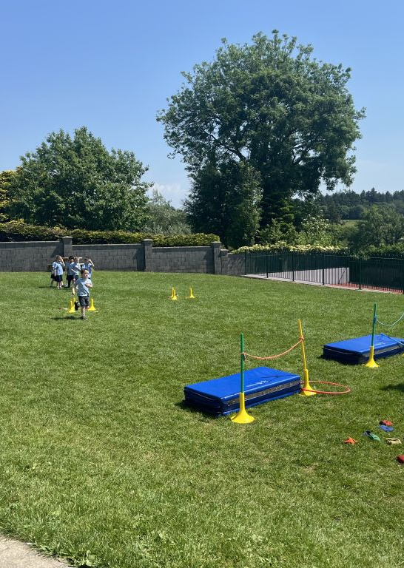
There are many different classrooms and many different adults in our school.
Everyone has a part to play.
I will have opportunities to learn, play, create, explore and make friends.
I can take time to become familiar with my new surroundings and the adults in my school.
I am becoming part of the Crehana National School community.
Being Part of Crehana N.S.

